Slide 1
TYPESCRIPT

Slide 2
ABOUT TYPE SCRIPT
Implementing a JavaScript-based application is more error-prone as it supports dynamic typing and supports non-strict mode with global variables.
TypeScript makes such implementations easy, as it supports static typing and structured code with the help of modules and object-oriented concepts.
TypeScript enables you to develop a highly structured, less error-prone JavaScript code using TypeScript features.

Slide 3
NEED FOR TYPESCRIPT
JavaScript is used for client-side scripting to do client-side validations, DOM manipulation and also, for writing complex business logic that runs at the client-side.
As the complexity of the JavaScript code increases, it gradually becomes difficult in coding and maintaining.
This is because of the limitations of the JavaScript language.

Slide 4
There is no option to change the language for the client-side scripting as the browser understands only JavaScript.
The solution is to choose a language that is rich in features and the code can be converted to JavaScript.
This process of converting the code written in one language into another language is called Transpilation.
TypeScript is one such language where its code can get transpiled to JavaScript.

Slide 5
PITFALLS OF JAVASCRIPT
Dynamic Typing: It decides the data type of the variable dynamically at run time.
Minimal Object Oriented support: Object-Oriented Programming (OOP) is a programming methodology based on the concept of objects.
Object-Oriented concepts like classes, encapsulation, inheritance help in the readability and reusability of the code.

Slide 6
Interpreted Language: It is a language in which the code instructions are executed directly without prior compilation to machine-language instructions.
Minimal IDE support: Integrated Development Environment (IDE) is a software application that provides all necessary options like code refactoring, intelliSense support, debugging support to software programmers for software development.

Slide 7
DYNAMIC TYPING
function calculateTotalPrice(quantity, unitPrice) {
return quantity * unitPrice;
}
We can invoke this function using the below code:
console.log(calculateTotalPrice(3, "500"));
Since JavaScript is dynamically typed, we can invoke the above function using the below code as well.
console.log(calculateTotalPrice('three', "500"));
Even though the above code will not throw any error, it will return NaN as output, since the expected number type value is not passed to the quantity argument of the calculateTotalPrice function.

Slide 8
To avoid the above runtime error we can use static typing in TypeScript, wherein we will add data type to the function argument while defining it.
Example: Same JavaScript function using TypeScript
function calculateTotalPrice( quantity: number, unitPrice: number) {
return quantity * unitPrice;
}

Slide 9
In the above code, we are adding a number as the data type to both the arguments of the function.
Hence when we invoke the function using the below code:
console.log(calculateTotalPrice('three', "500"));
We will get a compilation error since we are invoking the function with the first parameter as a string type.
Hence we can detect error early at compilation time itself.

Slide 10
INTERPRETED LANGUAGE
JavaScript is an interpreted language. The advantages are:
It takes less amount of time to analyze the source code.
Memory efficient as no intermediate object code will get generated.
The disadvantage is most of the errors can be identified only at run time.
This can be overcome by using TypeScript which will be transpiled to JavaScript and most of the errors will be fixed during the transpilation time itself.
Therefore, TypeScript saves the application development time for a JavaScript developer.

Slide 11
MINIMAL IDE SUPPORT
A few IDEs have code refactoring, IntelliSense support for JavaScript application development.
IntelliSense support helps in writing the code quickly.
Refactoring support helps in changing the variable or function names throughout the application quickly.

Slide 12
Most of the IDEs has good support for TypeScript, some are listed below:
Visual Studio with versions 2015, 2013, and so on
Sublime Text
Atom
Eclipse
Emacs
WebStorm
Vim

Slide 13
WHY TYPESCRIPT?
JavaScript application development has become easier with the help of the following tools:
npm can be used to download packages
webpack can be used to manage the complexity of applications.
Babel can be used to fetch the latest features of the language.
Tools like rollup and uglifyjs can be used to optimize application payloads.

Slide 14
prettier and eslint can be used to uphold code with consistent style as well as quality.
IDE like Visual Studio Code with Node.js environment can be used to run JavaScript code everywhere.
There is browser support challenge for the latest ES6 version of JavaScript. You can use ES6 transpilers like Babel to address this.
TypeScript can be another preferred option which is a superset of JavaScript and transpiles to the preferred version of JavaScript.

Slide 15
WHAT IS TYPESCRIPT?
Transplier converts the source code of one programming language to the source code of another programming language.
TypeScript makes the development of JavaScript more of a traditional object-oriented experience.
TypeScript is based on ECMAScript 6 and 7 proposals.
Any valid JavaScript is TypeScript.

Slide 16
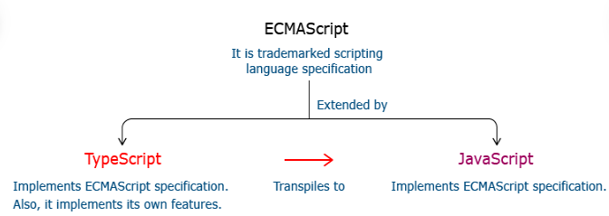
RELATIONSHIP BETWEEN TYPESCRIPT AND JAVASCRIPT

Slide 17
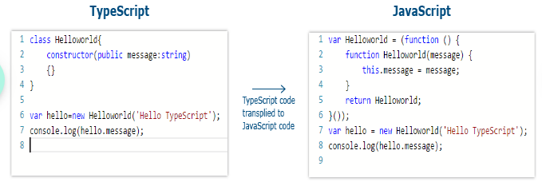

Slide 18
FEATURES OF TYPESCRIPT
Static Typing: It adds static typing to JavaScript, due to which the readability of the code improves and helps in finding more early compilation errors than run time errors.
Modules support: TypeScript provides an option to create modules to modularize the code for easy maintenance.
Supports Object-Oriented Programming: such as class, encapsulation, interface, inheritance and so on which helps in creating highly structured and reusable code.

Slide 19
FEATURES OF TYPESCRIPT
Open Source: TypeScript is open source. The source code of TypeScript can be downloaded from Github.
Cross-Platform: It works across the platform.
Tooling Support: TypeScript works extremely well with Sublime Text, Eclipse, and almost all major IDEs compared to JavaScript.

Slide 20
INSTALLING TYPESCRIPT
To install TypeScript, go to the official site of TypeScript ( http://www.typescriptlang.org/ ) and follow the steps mentioned there.
As mentioned on the official site, you need to install Node.js from the official site of Node.js
( https://nodejs.org/en/) or Software Center.
Open a Node.js command prompt and check whether node and npm are installed in your machine by using "node -v " and "npm -v" commands.

Slide 21
npm is a command-line tool that comes along with Node.js installation with which you can download node modules. TypeScript is also such a node module that can be installed using npm.
Open Node.js command prompt, execute the below commands as shown below to download the TypeScript node module.
npm i –g typescript
or
npm install –g typescript

Slide 22
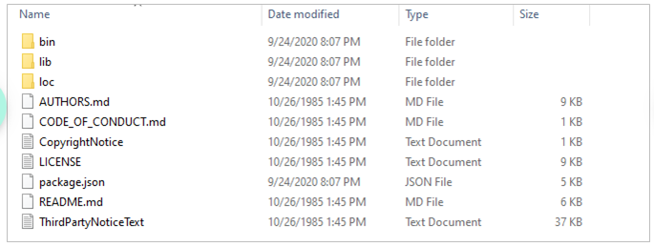
On successful execution of above command, the TypeScript module will get downloaded under folder C:\Users\<<username>>\AppData\Roaming\npm\node_modules\typescript as shown below.

Slide 23
In the same command prompt check for TypeScript installation as below:
tsc -v
//or
tsc --version
Output showing version number indicates the successful installation of the TypeScript module.

Slide 24

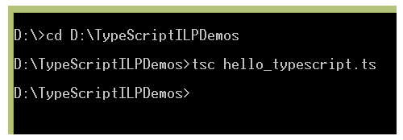
FIRST TYPESCRIPT APPLICATION
To start with the first application in TypeScript, create a file hello_typescript.ts under a folder. In the ts file give a console.log statement and save it.
From the Node.js command prompt, navigate to the directory in which the ts file resides and compile the ts file using the tsc command.

Slide 25
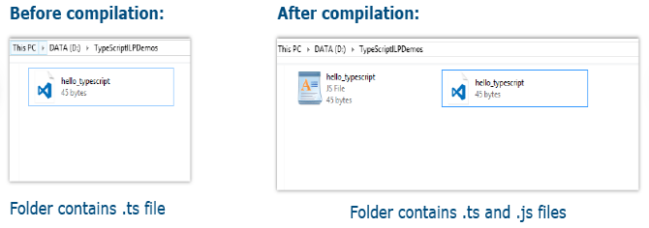
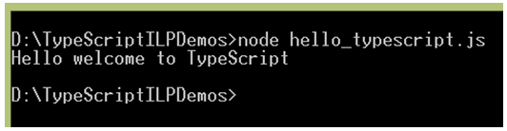
After compilation of the TypeScript file, the corresponding JavaScript file gets generated.
Run the compiled js file using node command.

Slide 26
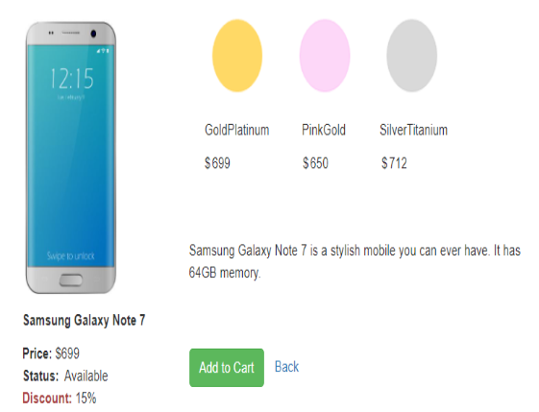
TYPESCRIPT BASICS
Consider the Mobile Cart application. The information such as mobile phone name, price, status on the availability of the mobile, discounts is displayed on the page. It also displays different price ranges as GoldPlatinum, PinkGold, SilverTitanium.

Slide 27
Each of the information getting displayed has a specific type. For example, the price can only be numeric and the mobile name can only be a string.
There should be a mechanism using which you can restrict the values being rendered on the page.
TypeScript is a static typed language that allows us to declare variables of various data types so that you ensure only the desired type of data being used in the application.

Slide 28
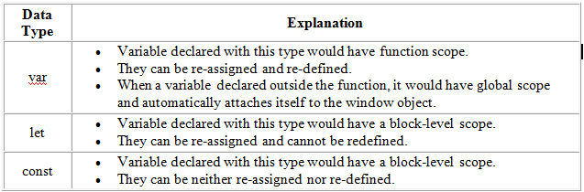
DECLARING VARIABLES
Declaration of a variable is used to assign a data type and an identifier to a variable. Declaration of variables in TypeScript is like JavaScript variable declaration.
Below are the three declaration types supported in TypeScript.

Slide 29
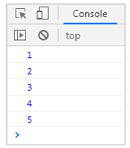
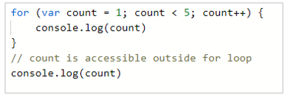
PROBLEM WITH VAR DECLARATION
In the below code, you will observe a strange behavior of the variable count. You can access this variable even outside the loop although it is defined inside the loop. This is due to the global scope nature of the var data type declaration.

Slide 30
Other problems with global scope variable are:
When the var declared variable is defined outside a function it is attached with the window object which has only one instance.
This is a bad practice and causes an overridden of a variable when you try to use a third-party library working with the same variable.
Generally, var variables have a function-scope and if they are not declared within a function, they have a global scope.
To overcome this issue, JavaScript has introduced let and const as two new declaration types and it is considered as standard because declaring variables by these two data types are safer than declaring a variable using the var keyword.

Slide 31
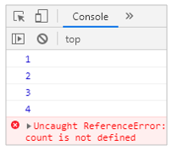
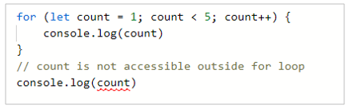
DECLARING VARIABLES USING LET KEYWORD
When a developer wants to declare variables to live only within the block, they can achieve a block-scoped variable using let declaration.

Slide 32
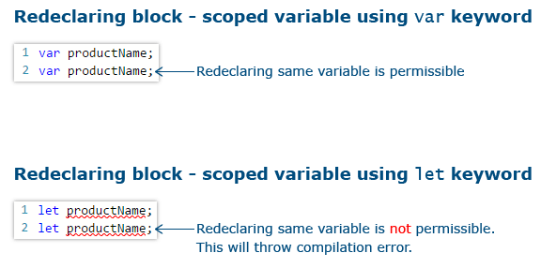
DIFFERENCE BETWEEN VAR AND LET KEYWORD
Due to these reasons let declaration is preferred over var declaration.

Slide 33
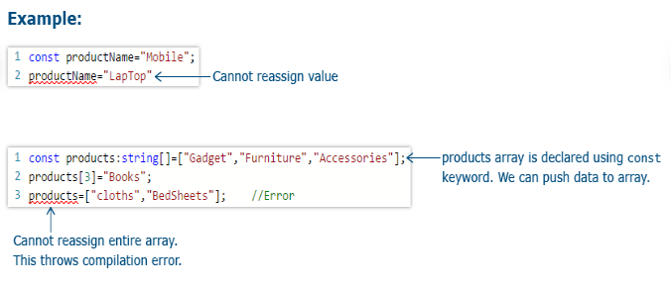
DECLARING VARIABLES USING CONST KEYWORD
The value cannot be re-assigned to the variable.
const declared variables are mutable if declared as an array or as an object literal.

Slide 34
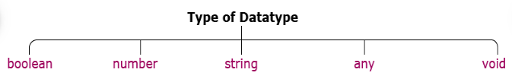
BASIC TYPES
Data type mentions the type of value assigned to a variable. It is used for variable declarations.
Since TypeScript supports static typing, the data type of the variable can be determined at the compilation time itself.

Slide 35

BOOLEAN
boolean is a data type that accepts only true or false as a value for the variable it is been declared.
In a shopping cart application, you can use a boolean type variable to check for the product availability, to show/hide the product image, etc.

Slide 36

NUMBER
number type represents numeric values. All TypeScript numbers are floating-point values.
In a shopping cart application, you can use number type to declare the Id of a product, price of a product, etc.

Slide 37

STRING
A string is used to assign textual values or template strings. String values are written in quotes – single or double.
In a shopping cart application, you can use string type to declare variables like productName, productType, etc.

Slide 38
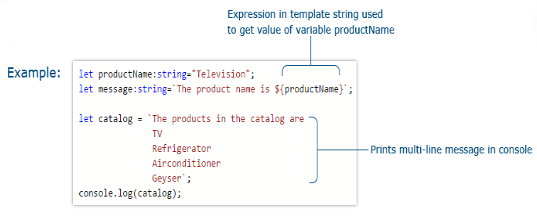
TEMPLATE STRINGS
Template strings are types of string value that can have multiple lines and embedded expressions. They are surrounded by the backquote\backtick (`) character and embedded expressions of the form ${ expr }.

Slide 39
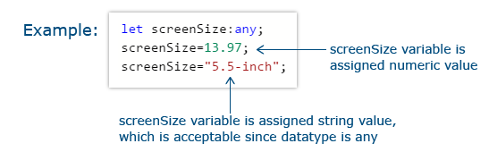
ANY
‘any’ type is used to declare a variable whose type can be determined dynamically at runtime with the value supplied to it. If no type annotation is mentioned while declaring the variable, any type will be assigned by default.
In a shopping cart application, you can use any type to declare a variable like screenSize of a Tablet.

Slide 40
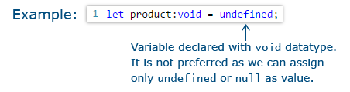
VOID
void type represents undefined as the value. the undefined value represents "no value".
A variable can be declared with void type as below:

Slide 41
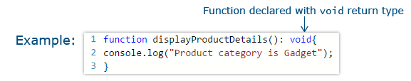
void type is commonly used to declare function return type. The function which does not return a value can be declared with a void return type. If you don’t mention any return type for the function, the void return type will be assigned by default.

Slide 44
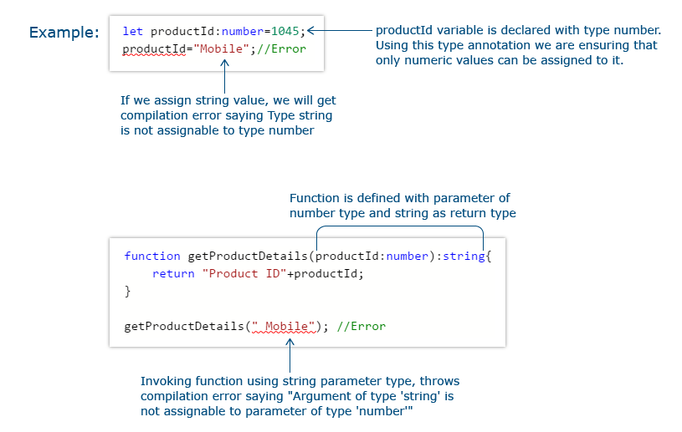
TYPE ANNOTATIONS
To enforce type restriction to a specific variable or a function. If a variable is declared with a specific data type and another type of value is assigned to the variable, a compilation error will be thrown.

Slide 45
ENUM
Enum in TypeScript is used to give more friendly names to a set of numeric values.
For example, if you need to store a set of size variables such as Small, Medium, Large with different numeric values, group those variables under a common enum called Size.
By default, enum’s first item will be assigned with zero as the value and the subsequent values will be incremented by one.

Slide 46
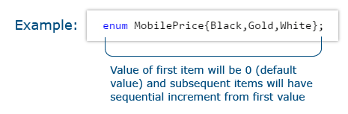
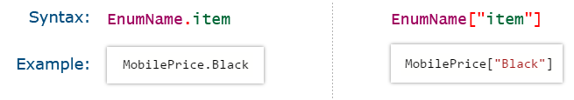
In a shopping cart application, you can use a MobilePrice enum to store different prices of the mobile depending on the mobile color.
To get the value from an enum use one of the following:

Slide 47
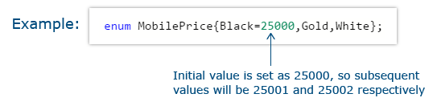

Enum items can also be initialized with different values than the default value. If you set a different value for one of the variables, the subsequent values will be incremented by 1.
You can even set different values to different enum items

Slide 48
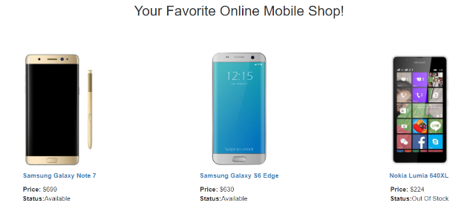
ARRAYS
Consider the Mobile Cart application that displays the list of mobile phones available. For each mobile in the list, you can see its image, name, price, and availability status.

Slide 49
This requirement is implemented using the concept of arrays of TypeScript.
An Array is used to store multiple values in a single variable. You can easily access the values stored in an array using the index position of the data stored in the array.
TypeScript array is an object to store multiple values in a variable with a type annotation. They are like JavaScript arrays.

Slide 50
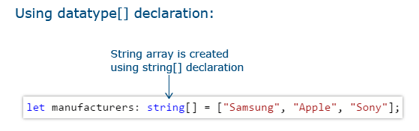
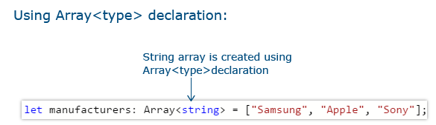
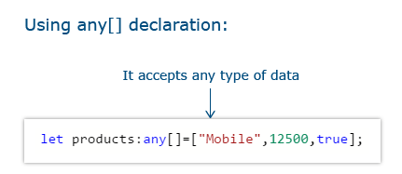
Arrays can be created using one of the below:

Slide 51
A TypeScript array defined with a specific type does not accept data of different types. TypeScript arrays can be accessed and used much like JavaScript arrays.
JavaScript Arrays has several useful properties and methods to access or modify the given array. The same is supported in TypeScript.
To add a dynamic value to an array, you can either use the push function or use the index reference.

Slide 52
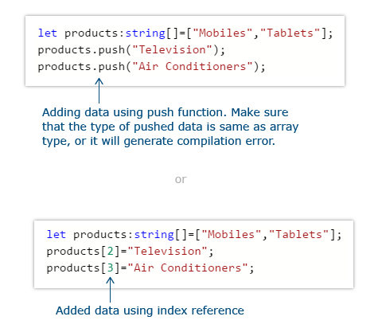

Slide 53
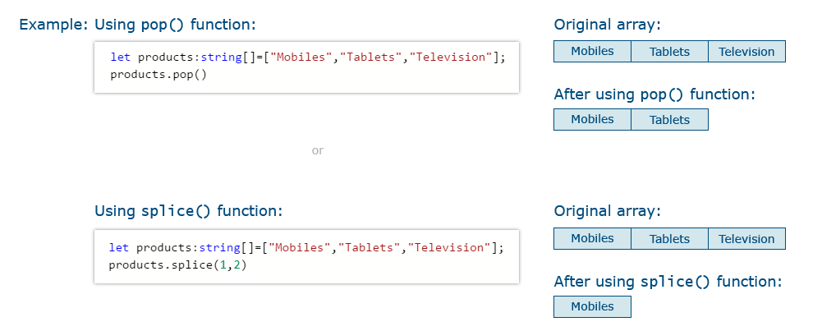
Data can be removed from an array using the pop function or splice function
The splice function removes the item from a specific index position.

Slide 54
TUPLE
Arrays are used to represent a collection of similar objects, whereas tuples are used to represent a collection of different objects.
Let us consider an example, where customerCreditId, Customer object, and customerCreditLimit must be represented in a data type.
The choice could be to define a class, with these properties. If it is represented using the class, then there will be a requirement to instantiate the class and then the properties can be accessed.

Slide 55
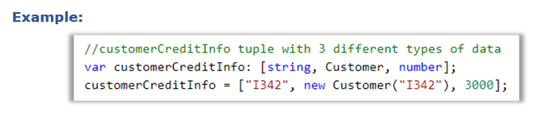
Tuples provides an easy way to implement the same scenario with an array-like data structure, which is easy to access and manipulate.
In order to access the customerCreditId, you can use customerCreditInfo[0].
In order to access the customer object, you can use customerCreditInfo[1].

Slide 56
In a shopping cart application, you can use tuples to store product details that should require more than one type of data.
The order of the first set of data entries while initializing a tuple variable should be the same as the order in which the type is declared in a tuple.
A compilation error will be thrown in below two cases:
  if you are trying to assign multiple entries in the first initialization.
  if you try to initialize different datatypes directly to the tuple declared variable.
In order to overcome the above-mentioned compilation errors, you can use the push() method.

Slide 57
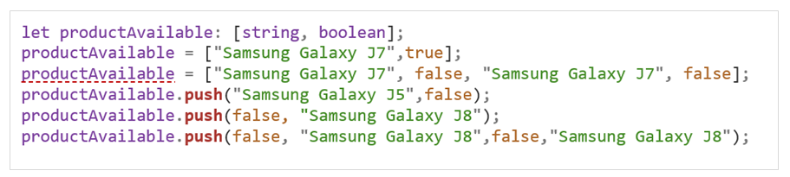
EXAMPLE:
In the above example, the underlined error is due to multiple declarations in the first initialization which violates the length restriction policy. To avoid this, the push method can be used as shown in the code.

Slide 58
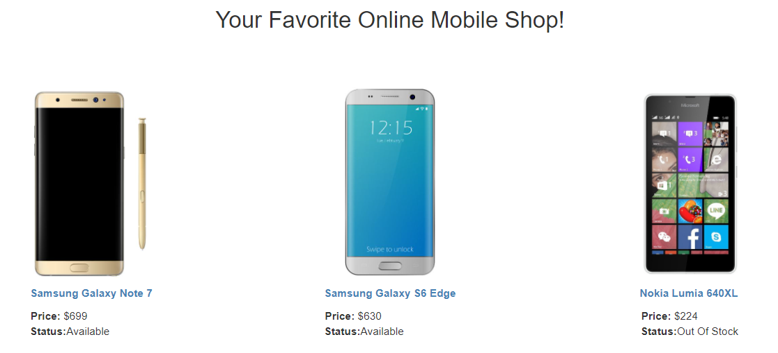
WHY FUNCTION?
For each mobile in the list, you can see its image, name, price, and availability status. The property ‘name’ of the mobile is clickable.

Slide 59
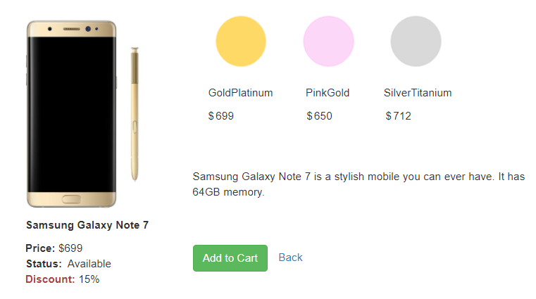
When the mobile name link is clicked, the user is navigated to the next screen which shows the details specific to the phone selected. The details such as different colors in which the phone is available, price of mobile according to the color selected, description of the phone, availability status, and discounts if any.

Slide 60
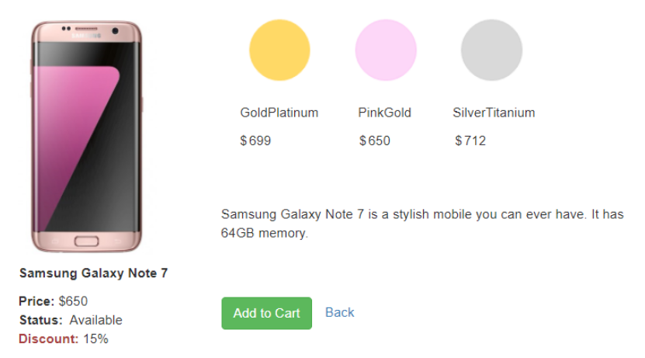
Users can click on each color to view the mobile image for that color. The Price corresponding to the color selected can also be shown. For example: On click of PinkGold the below screen should be rendered:
This requirement is implemented using the function concept in TypeScript that helps us to implement business logic and event handlers.

Slide 61
FUNCTION IN TYPESCRIPT VS JAVASCRIPT
A function is a block of statements to perform a particular task.
A sequence of statements written within function forms function body.
Functions are executed when it is invoked by a function call. Values can be passed to a function as function parameters and the function returns a value.
Functions in TypeScript are like functions in JavaScript with some additional features.

Slide 62
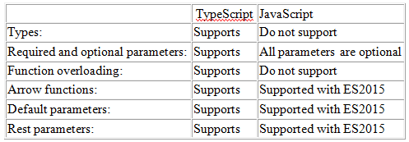

Slide 63
PARAMETER TYPES AND RETURN TYPES
The parameter type is the data type of the parameter and the return type is the data type of the returned value from the function.
While defining the function, return the data with the same type as the function return type. While invoking the function you need to pass the data with the same data type as the function parameter type, or else it will throw a compilation error.

Slide 64
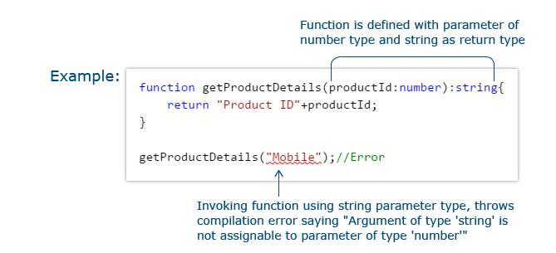

Slide 65
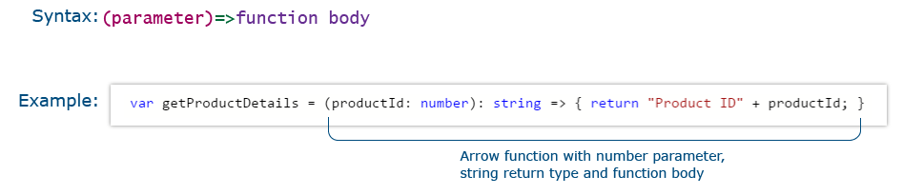
ARROW FUNCTION
Arrow function is a concise way of writing a function. Whenever you need a function to be written within a loop, the arrow function will be the opt choice.
Do not use the function keyword to define an arrow function.
In a shopping cart application, you can use the arrow function to perform filtering, sorting, searching operations, and so on.

Slide 66
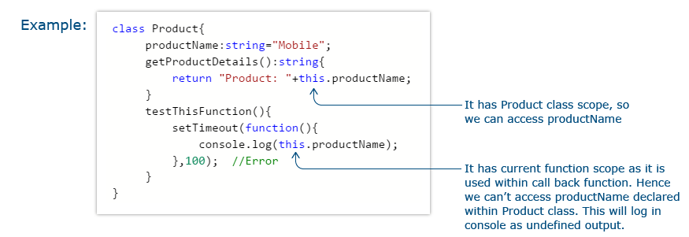
HANDLING ‘THIS’ KEYWORD IN JAVASCRIPT
In a class, if a method wants to access the property of the class it should use this keyword.

Slide 67
For a particular object, this keyword will help to access the properties of the current object. This is possible because all the methods and properties are within the same scope.
In the above example, when you use this.productName inside the getProductDetails method, and productName variable are in the same scope. Also, you get the desired result.
But when you use this.productName inside the setTimeout function, instead of directly using it in testThisFunction method, the scope of this.productName will be inside the setTimeout's callback function and not the testThisFunction method. That is the reason you are unable to access the value of productName for that particular object.

Slide 68
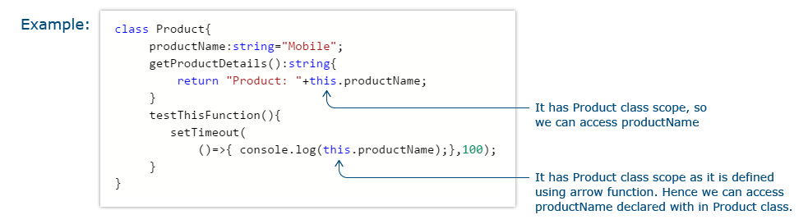
If you need to access the class scope with this keyword inside the callback function then use the arrow function.
Arrow function lexically captures the meaning of this keyword.
Rewrite the same logic using the arrow function as below:

Slide 69
In the above code, this.productName is written inside an arrow function.
Since the callback function of setTimeout is implemented using the arrow function, it does not create a new scope and it will be in the same scope as the testThisFunction method.

Slide 70
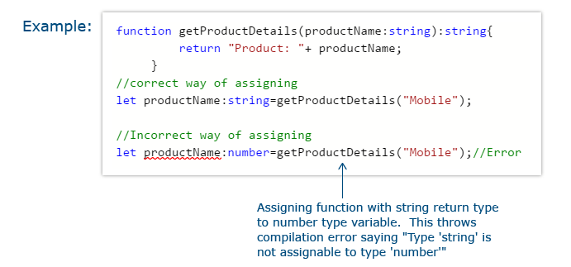
FUNCTION TYPES
Function types are a combination of parameter types and return type. Functions can be assigned to variables.
While assigning a function to a variable make sure that the variable declaration is the same as the assigned function’s return type.

Slide 71
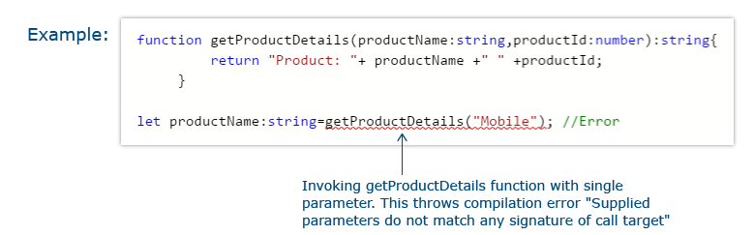
OPTIONAL AND DEFAULT PARAMETERS
TypeScript treats every function parameter as mandatory. So when a function is compiled, the compiler will check whether there is a value supplied to all the parameters of the function, or else it will throw a compilation error.
Consider the code below:

Slide 72
In the above example, you have tried to invoke a function with only a single parameter, whereas the definition of the function accepts two parameters. Hence, it will throw a compilation error. Also, optional parameter can be used to tackle this issue.
The Optional parameter is used to make a parameter, optional in a function while invoking the function.

Slide 73
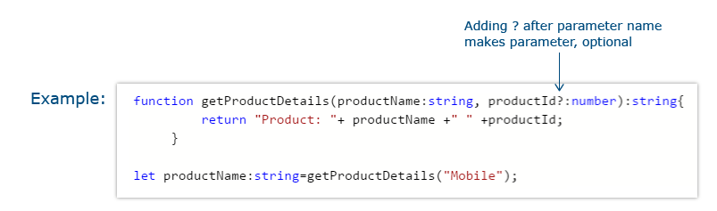
If you rewrite the previous code using an optional parameter, it looks like the below:

Slide 74
An Optional parameter must appear after all the mandatory parameters of a function.
Default parameter is used to assign the default value to a function parameter.
If the user does not provide a value for a function parameter or provide the value as undefined for it while invoking the function, the default value assigned will be considered.

Slide 75
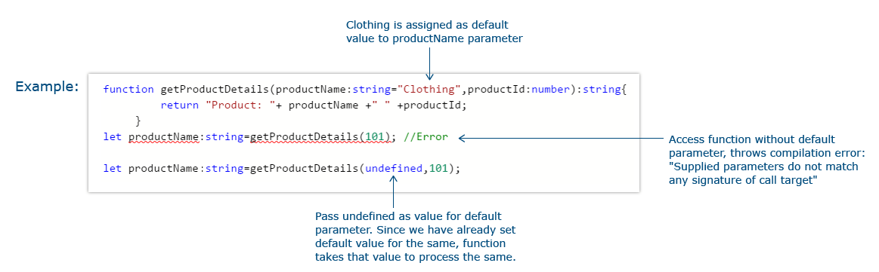
If the default parameter comes before a required parameter, you need to explicitly pass undefined as the value to get the default value.

Slide 76
REST PARAMETER
Rest Parameter is used to pass multiple values to a single parameter of a function. It accepts zero or more values for a single parameter.
Rest Parameter should be declared as an array.
Precede the parameter to be made as rest parameter with triple dots.
Rest parameter should be the last parameter in the function parameter list.

Slide 77
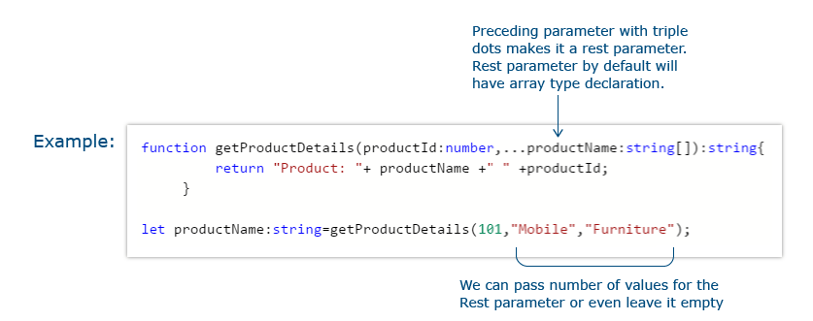

Slide 78
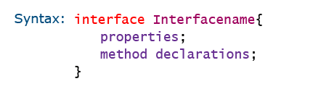
WHAT IS AN INTERFACE?
An interface in TypeScript is used to define contracts within the code.
Interfaces are used to enforce type checking by defining contracts.
It is a collection of properties and method declarations.
Interfaces are not supported in JavaScript and will get removed from the generated JavaScript.

Slide 79
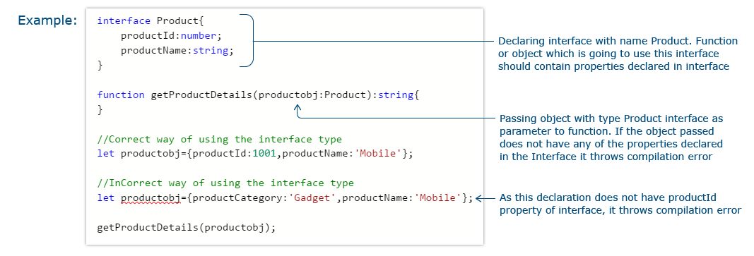
HOW TO CREATE AN INTERFACE?

Slide 80
DUCK TYPING
Duck-Typing is a rule for checking the type compatibility for more complex variable types.
TypeScript compiler uses the duck-typing method to compare one object with the other by comparing that both the objects have the same properties with the same data types.
TypeScript interface uses the same duck typing method to enforce type restriction.

Slide 81
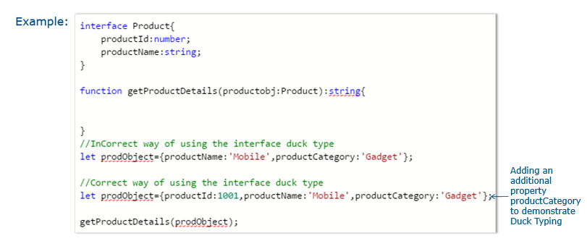
If an object that has been assigned as an interface contains more properties than the interface mentioned properties, it will be accepted as an interface type and additional properties will be ignored for type checking.

Slide 82
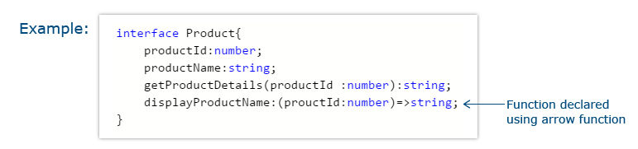
DEFINING AN INTERFACE
Interface keyword is used to declare an interface.
An interface should have properties and method declarations.
Properties or methods in an interface should not have any access modifiers.
Properties cannot be initialized in a TypeScript interface.

Slide 83
FUNCTION TYPES
Interfaces can be used to define the structure of functions like defining structure of objects.
Once the interface for a function type is declared, you can declare variables of that type and assign functions to the variable if the function matches the signature defined in the interface.
Function type interface is used to enforce the same number and type of parameters to any function which is been declared with the function type interface.

Slide 84
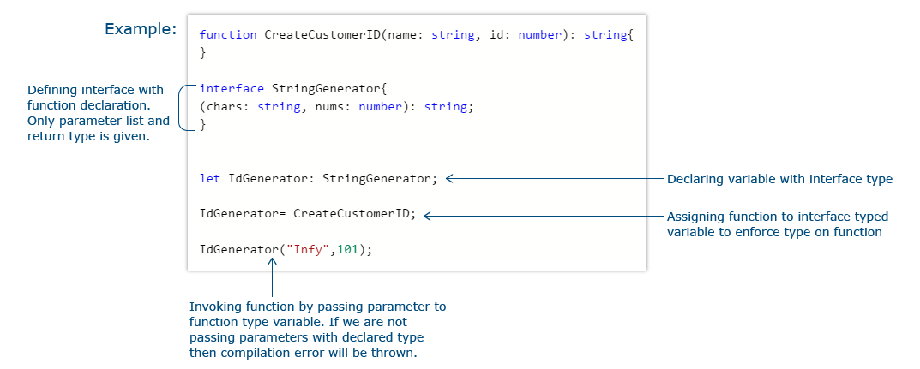

Slide 85
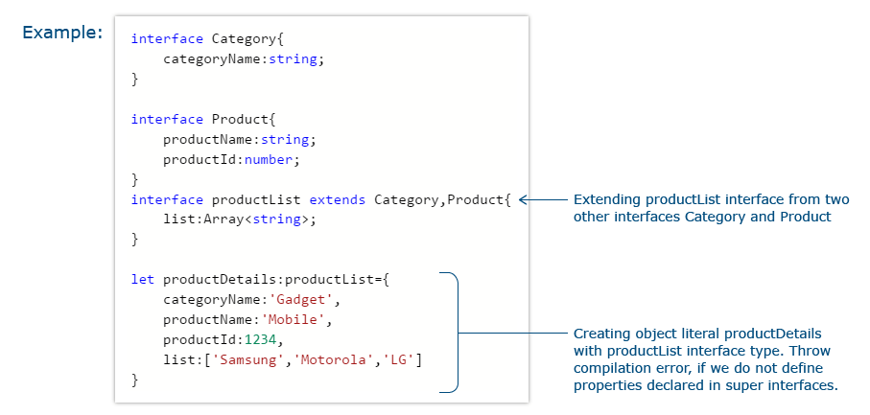
EXTENDING INTERFACES
An interface can be extended from an already existing one using the extends keyword.
In the code below, extend the productList interface from both the Category interface and Product interface.

Slide 86
CLASS TYPES
Use implements keyword to implement interface inside a class.
To enforce interface type on a class, while instantiating an object of a class declare it using the interface type.
The only interface declared functions and properties will be available with the instantiated object.

Slide 87


Slide 88
WHY CLASSES
Classes are used to create reusable components. Till the ES5 version of JavaScript, you do not have a class concept as such.
For implementing reusable components, use functions and prototype-based inheritance.
TypeScript provides an option for the developers to use object-oriented programming with the help of classes.

Slide 89

In the Mobile Cart application, you can use a class to define the product and create various objects of different products. In the below screen, creating different objects of product and rendering the details

Slide 90

WHAT IS A CLASS?
Class is a template from which objects can be created.
It provides behavior and state storage.
It is meant for implementing reusable functionality.
Use a class keyword to create a class.

Slide 91
CONSTRUCTOR
A constructor is a function that gets executed automatically whenever an instance of a class is created using a new keyword.
To create a constructor, a function with the name as a "constructor" is used.
A class can hold a maximum of one constructor method per class.
You can use optional parameters with a constructor function as well.

Slide 92


Slide 93

ACCESS MODIFIERS
Access modifiers are used to provide certain restriction of accessing the properties and methods outside the class.

Slide 94

PUBLIC AND PRIVATE ACCESS MODIFIERS

Slide 95


Slide 96

PROTECTED ACCESS MODIFIER

Slide 97
STATIC ACCESS MODIFIER
Static keyword can be used to declare a class variable or method.
A static variable belongs to the class and not to the instance of the class.
A variable or function declared with a static keyword can be accessed using the class name instead of the instance of the class.
Static variables are initialized only once, at the start of the execution.
A single copy of the static variables would be shared by all instances of the class.

Slide 98

A static variable can be accessible inside the static function as well as the non-static function.
A static function can access only static variables and other static functions.

Slide 99

PROPERTIES AND METHODS –
PARAMETER PROPERTIES
Instead of declaring instance variables and then passing parameters to the constructor and initializing it, you can reduce the code by adding access specifiers to the parameters passed to the constructor.

Slide 100

Instead of this declare the parameter itself with any of the access modifiers and reduce the lines of code used for the initialization.

Slide 101
PROPERTIES AND METHODS- ACCESSORS
TypeScript provides an option to add getters/setters to control accessing the members outside the class or modifying the same.
There is no direct option available to access private members outside the class but use accessors in TypeScript for the same.

Slide 102

If you need to access private properties outside the class, you can use the getter and if you need to update the value of the private property, you can use the setter.

Slide 103


Slide 104
EXTENDING CLASSES WITH INHERITANCE
Inheritance is the process of extending a class from an already existing class and reuse the functions and properties of the inherited class in the subclass.
TypeScript supports inheritance with class, wherein the superclass functionalities can be reused within the subclass.

Slide 105

The subclass constructor function definition should invoke the superclass constructor using the super function.

Slide 106

Use the super keyword to access the methods of the super class inside the subclass methods.
Override the superclass methods inside the subclass by specifying the same function signature.

Slide 107
MODULES AND NAMESPACES
Modules and Namespaces are useful in grouping functionalities under a common name.
The main use is reusability.
Code can be reused by importing modules or namespaces in other files.
Namespaces are used for namespace resolution and are suitable for the development of a smaller application.
In larger-scale applications, they can be used to achieve modularity.

Slide 108
TypeScript provides native support in terms of module loaders using modules concept which takes care of all the concerns with respect to modularity.
In the MobileCart application, create a product utility namespace or module and place the code related to the product in it. Reuse the code related to the product by importing it into other files.

Slide 109
WHAT IS NAMESPACE?
A Namespace is used to group functions, classes, or interfaces under a common name.
A namespace is a programming concept that gives identifiers (names of types, functions, variables, etc.) scope to avoid name conflicts. For instance, a program may need to use the same variable name in many contexts.

Slide 110
The content of namespaces is hidden by default unless they are exported.
Use nested namespaces if required.
The function or any construct which is not exported cannot be accessible outside the namespace.

Slide 111


Slide 112

CREATING AND USING NAMESPACES
In the below example, create a namespace called Utility and group a function MaxDiscountAllowed and a nested namespace called payment inside it.

Slide 113

To import the namespace and use it, make use of the triple slash reference tag.

Slide 114

The file in which the namespace is declared and the file which uses the namespace to be compiled together. It is preferable to group the output together in a single file. You have an option to do that by using the --outFile keyword.

Slide 115
WHAT IS A MODULE?
Modules help us in grouping a set of functionalities under a common name. The content of modules cannot be accessible outside unless exported.
Precede export keyword to the function, class, interface, etc.. which you need to export from a module.

Slide 116


Slide 117

EXPORTING FROM A MODULE
The constructs of a module can be exported by one of the below approaches:
1. Adding an export keyword in front of a function or a class or an interface
2. Adding an export keyword to a block of statements

Slide 118

IMPORTING A MODULE
Using the import keyword, you can import a module within another module or another TypeScript file. Provide the file name as the module name while importing.
Once the module is imported, make use of the classes and other constructs exported from the module.

Slide 119

Also, alias names can be used while importing/ exporting a module.

Slide 120

COMPILING MODULE
To compile the modules and the file which is using the module, compile them together using the tsc command.

Slide 121

MODULE FORMATS AND LOADERS
Module format is the syntax that is used to define a module in JavaScript.
Modules in TypeScript can be compiled to one of the module formats given below:

Slide 122
Commonly we compile the modular code in TypeScript to ES2015 format by using the --module ES2015 keyword while performing the compilation.
If none of the formats are mentioned in the compiler option, by default CommonJS module format will be the one that gets generated while compiling modules in TypeScript.

Slide 123
A module loader interprets and loads a module written in a certain module format as well as helps in importing all the dependent modules into developer working environment.
At the runtime, they play a very vital role in loading and configuring all needed dependencies modules before executing any linked module.
The most commonly used module loaders in JavaScript are:
SystemJS module loader for modules in AMD, CommonJS, UMD, or System.register format
Require.js module loader for modules in AMD format.

Slide 124
On-demand functionalities can be loaded by Modules, which is known as lazy loading.
By using this feature while executing our application all the declared modules are not loaded at that moment, it only loads needed modules that are needed by the user to render the initial look of the application on the first load.
Due to this concept performance of the application can be enhanced as the initial startup time of the application automatically decreases.

Slide 125
DEFAULT EXPORTS
Default export is used to export any one of the constructs such as class, interface, function, and so on from the current module as a default one.
Default exports are handy in case you need to export a class that has almost all functionalities attached, such as javascript library object jQuery.
Name for the default exported constructs are optional. You can assign a name to the default construct while importing it into the other file.

Slide 126

As you cannot have more than one default export per module.

Slide 127


Slide 128

MODULE VS NAMESPACE

Slide 129
WHY GENERICS?
Generics helps us to avoid writing the same code again for different data types.
In TypeScript, generics are used along :
with function to invoke the same code with different type arguments
with Array to access the same array declaration with a different set of typed values
with Interface to implement the same interface declaration by different classes with different types
with a class to access the same class with different types while instantiating it

Slide 130
WHAT IS GENERICS?
Generics is a concept using which we can make the same code work for multiple types.
It accepts type parameters for each invocation of a function or a class or an interface so that the same code can be used for multiple types.

Slide 131

Consider the below code where you implement a similar function for two different types of data:

Slide 132

Avoid writing the same code again for different types using generics. Let us rewrite the above code using generics:

Slide 133

WHAT ARE TYPE PARAMETERS?
Type Parameters are used to specify the type, a generic will work over.
They are listed using an angle bracket<>.
The actual type will be provided while invoking function or instance creation.
Consider a generic function given below:

Slide 134

To access this function with different types you will use the below code:

Slide 135

GENERIC ARRAY
Using Array<T>
Array<T> provides us the option to use the same array declaration for different types of data when used along with a function.
<T> here represents the type parameter.

Slide 136


Slide 137

GENERIC FUNCTIONS
Generic functions are functions declared with generic types.
Declaring generic function is done using the type parameter and using the same type variable for the parameter and the return type.

Slide 138

GENERIC INTERFACE
Generic interface is an interface that works with multiple types.

Slide 139

This interface can be implemented by different classes with their own types.

Slide 140


Slide 141


GENERIC CLASS
Generic class is a class that works with multiple types.

Slide 142

Consider the generic class given below:
The same class instance can be instantiated and invoked with different type parameters.

Slide 143

GENERIC CONSTRAINTS
Generic constraints are used to add constraints to the generic type.
Generic constraints are added using the 'extends' keyword.

Slide 144

Consider the below code:
Here you are trying to access the length property of the function type parameter.
Since the parameter type will get resolved only at run time, this line will throw compilation

Slide 145

To resolve this, you can add a constraint with the type parameter.
If you need to access a property on the type parameter, add those properties in an interface or class and extend the type parameter from the declared interface or class.

Slide 146

To invoke this generic function, you can pass any parameter which has a length property.

Slide 147
Thank You

